Slide 1
Hide and Display

Slide 2
Agenda
Hide and Display
Sample output
Hide and Display implementation

Slide 3
Hide and Display
We can hide a class or id with the help of display property.
We can view it by hovering the mouse on a different class.
Syntax:
Hide a class using CSS property
.B{ display: none;}
View the hidden class B when we hover on class A
.A{style class A}
.A:hover + .B{ display: block;}
<body>
<p class="A">Some text here</p>
<p class="B">ABCDEFGHIJKLMNOPQRSTUVWXYZ</p>
</body>

Slide 4
Hide and Display
Similarly to display property we have visibility property to hide the content.
Visible, hidden, collapse are the three values of visibility property.
Hidden:
Using visibility: hidden, the content will be hidden but not the space given for the content will still be on the screen.
Visible:
With visibility: visible, the content will be visible on the screen.

Slide 5
Hide and Display
Collapse:
Collapse will also hide the content but it will also clear the space from the page for that content. Collapse is useful only if we use it for table rows, columns, row groups and column groups. Incase if we use it for any other tags, it will simply act as hidden.
visibility: collapse (effects only for row <tr>, column <col>, row group <tbody>, column group <colgroup>. Else acts as hidden.)

Slide 6
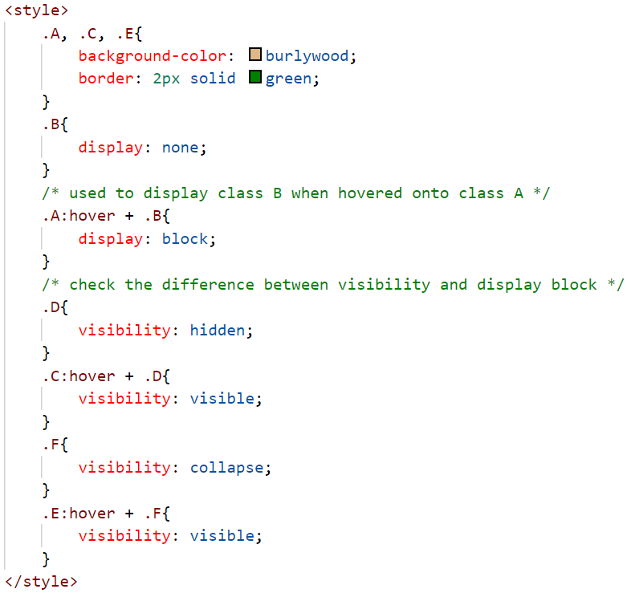
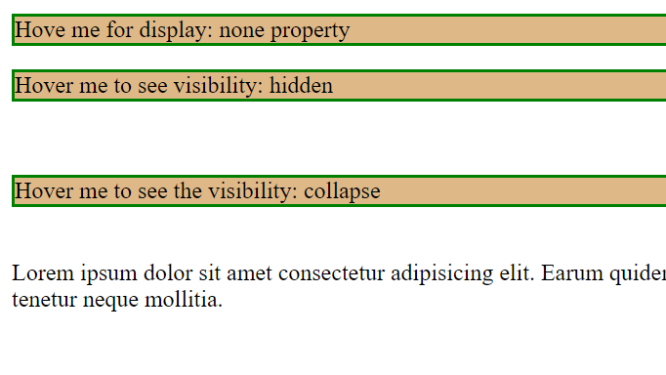
Sample output

Slide 7
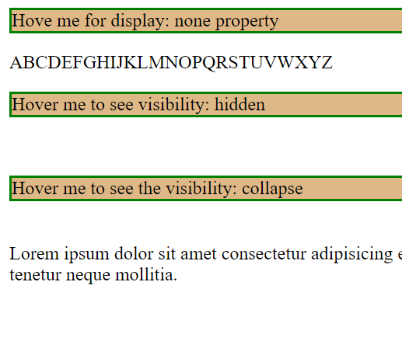
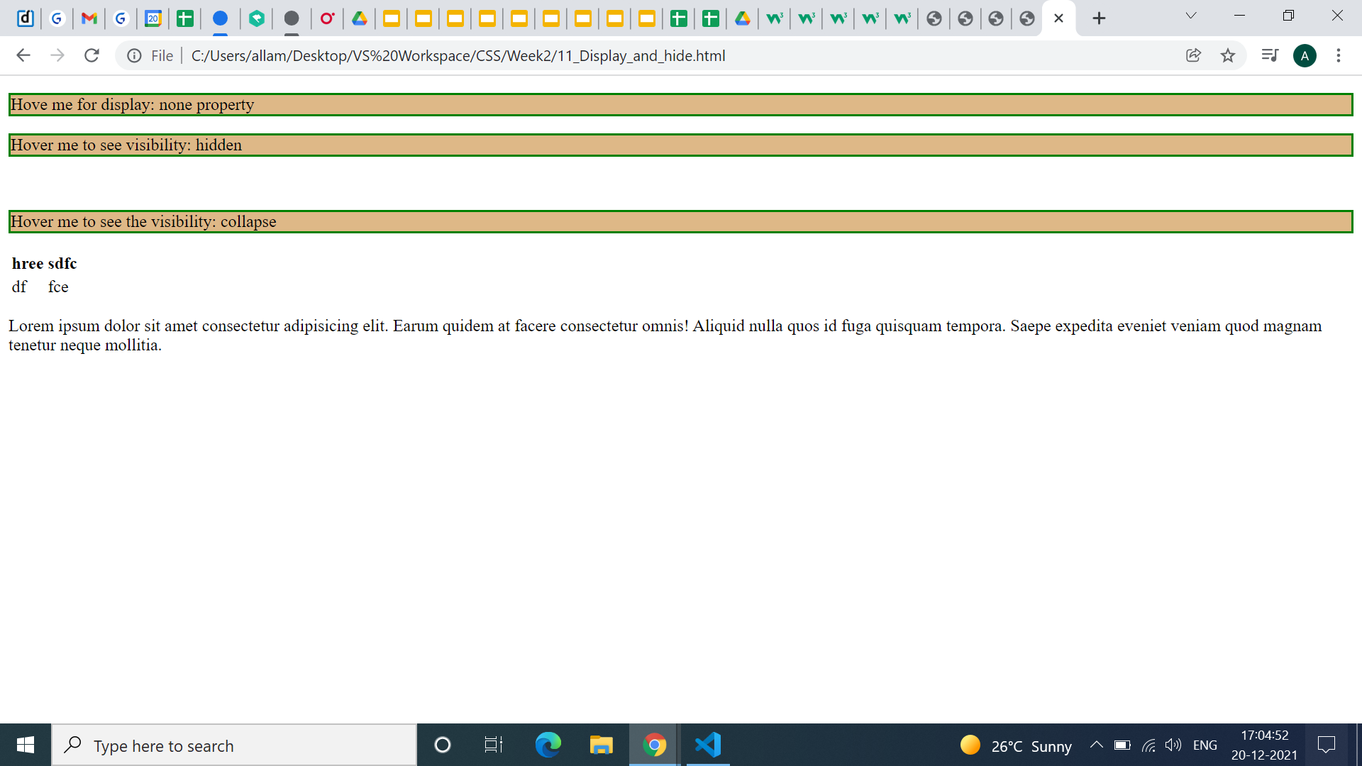

Sample output

Slide 8
Hide and Display implementation
Let’s see the implementation of the same.

Slide 9
Summary
We can hide and display html tags with the help of display property.
DO NOT WRITE ANYTHING
HERE. LEAVE THIS SPACE FOR
WEBCAM

Slide 10
Thank You
Proprietary content. ©Great Learning. All Rights Reserved. Unauthorized use or distribution prohibited

